Slide 1


Computer Science Club
2021-2022
Welcome! We are so happy to have you here!

Slide 2
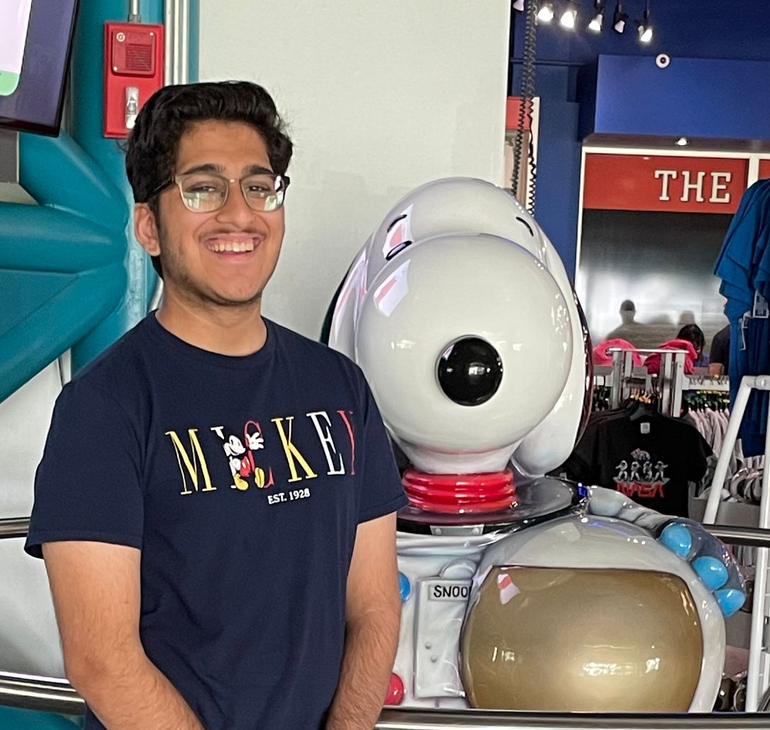
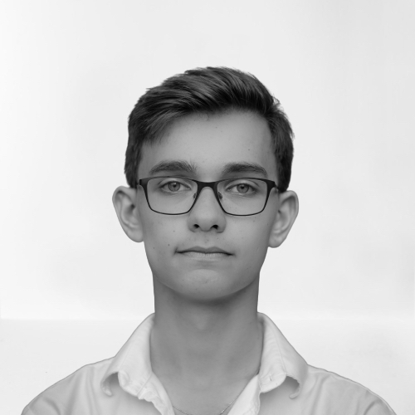
About Us
Hey guys! I got into programming via web development, but I have been branching out ever since via self-paced bootcamps and books. In the past, I have designed websites for 2 nonprofits using a variety of tools. This year, I’ll be taking two computers classes at NCSSM, including one in Data Science!
Arnav Sareen
Hey everyone! I have more of a knowledge base in Python, and more of the backend things as well as algorithms and Android app development. I am currently working on 2 projects on my own time, and I took 2 CS classes in college this summer, one in Python Algorithms/Data Types and another in WebDev. I am very excited to be leading this club!
Fillip Cutiuba

Slide 3



What will we do in Compsci club?
Programming
Collaborate
Discover
As the name implies, we are going to do a lot of hands-on programming activities in CompSci Club! Last here, we exclusively did Python, but this year is different!
Computer Science is not a solo journey! You learn and have a lot more fun when you work together. Through our cloud IDE and Git, we plan for you guys to work together alot!
There is always something new to find out in CompSci! From guest speakers to working with other clubs, we have so much planned this year!

Slide 4





Who can Join CompSci Club? (Anyone!)
Track ONe
Track Two
Taught by Arnav
Taught by Fillip
Perfect for beginners or people who have never coded in Python before!
Ideal for those who attended CompSci last year or have coding experience
A comprehensive and detailed curriculum that starts with the basics and works up
A review of the basics before delving into deeper and more powerful topics
Interactive projects and exercises to put your knowledge into practice
Interactive projects and exercises to put your knowledge into practice!

Slide 5


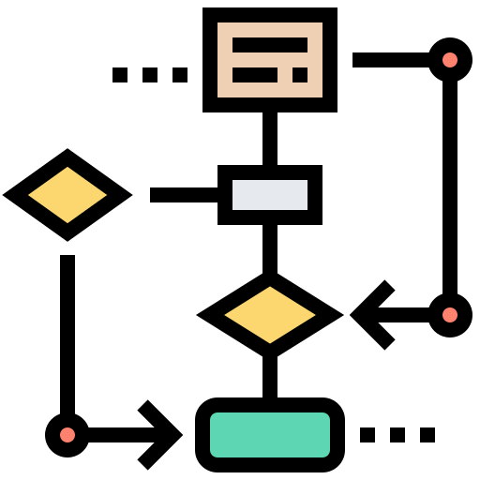




What are some specifics of CompSci?
Data Types in Python
Using Github to share code
Code Process & Flowcharts
GUIs
For and While Loops
Web Development
Whatever you want!

Slide 6



What if I miss a meeting?
We realize that having an after school club can sometimes lead to you not being able to make it
We have an organized Google Drive folder and GitHub so that you can access everything that Computer Science does
Now of course, we would love to have you at the meetings, so please do come in when you can!

Slide 7
Ask us about anything!
Questions?
Thank you so so much for attending the first CS meeting of this year! We will see you all in 2 weeks for our first meeting on September 13th!

